Slide 1
Core Ethical concepts for Minnesota mediators
Leslie Sinner McEvoy, Esq.
McEvoy Conflict Management & Legal Education Consulting
Mediation Center Training - October 4, 2024
Notes:
My goal this afternoon is to introduce you to the most important ethical issues and rules that will be important to you as mediators, with a focus on Rule 114.

Slide 2
Leslie Sinner McEvoy, Esq.
Mediator, Arbitrator, Teacher, Trainer and Consultant
Teaching, Studying, Writing about Rule 114 since 2008
Website: www.lesliemcevoy.com
Email:
leslie@lesliemcevoy.com
mcevoyleslie@gmail.com
Notes:
This is a brand new rule. I am as eager to share what I have learned as to learn from all of you. Please participate in the polls that ask about you and that ask for your impressions. Please feel free to ask questions or make comments, I will get to as many as I can and I will get back to you after the course if I am unable to do so in our time today.

Slide 3
READ THE RULES!

Slide 4
AGENDA
Sources of Ethical & Legal Duties for Rule 114 Mediators
Scenarios – Selected Ethical Dilemmas – Chronological approach
Round Table Discussion
Applicable Rules & Concepts
Practice Tips
Notes:
We will be using a series of ethical dilemmas with multiple choice answers. I will be asking for volunteers to offer their ideas about the best answers and to get a read on your reaction to these dilemmas – you have not had an opportunity to prepare, so just respond with your gut reaction where you don’t know and we will see how that compares to what the rules may require

Slide 5
Sources of Ethical & Legal Duties
Rule 114.13 (A) Code of Ethics for Court-Annexed ADR Neutrals (2024)
Rule 114 of the Minnesota General Rules of Practice (2024)
AAA/ABA/ACR Model Standards of Conduct for Mediators (2005) [“MSCM”]
Minnesota Civil Mediation Act
Minn. Stat. 595.02 Testimony of Witnesses
Minnesota Rules of Professional Conduct [MRPC]
Other programs and contexts
Notes:
Who is familiar with these standards? Read? Which? Why ethical AND legal? Because they are often intertwined – the legal standard create ethical duties….

Slide 6
Rule 114.01 Applicability: “Court-Annexed” ADR
114.01(b) Applicability of Ethics Rules to All Neutrals “All Neutrals serving in court-annexed ADR Processes under this rule are subject to the authority of the ADR Ethics Board and the Code of Ethics for Court Annexed ADR Neutrals, without regard to whether they are Qualified Neutrals as defined in Rule 114.02.”
114.13. (A) Code of Ethics for Court-Annexed ADR Neutrals – Introduction
“This Code of Ethics governs Neutrals appointed or serving by agreement of the parties in any court-annexed ADR proceedings.”

Slide 7
Rule 114: Not applicable in “non-court contexts”
“Rule 114 governs ADR as a tool of managing pending litigation. The procedures employed may mirror those available to resolve disputes wholly outside the court-based litigation process, but Rule 114 does not govern ADR in those non-court contexts.”
Rule 114.01 Applicability, Advisory Committee Comments – 2022 Amendments

Slide 8
Rule 114 - Overview
Procedure – 114.01 to 114.11
Neutrals – 114.12 & 114.13
Rosters & Training – 114.12
Ethics – 114. 13
114.13 (A) Code of Ethics for Court-Annexed ADR Neutrals
114.13 (B) Rules of the Minnesota ADR Ethics Board

Slide 9
Rule 114.13 (A) Code of Ethics for Court-Annexed ADR Neutrals
Subd. 1. Impartiality
Subd. 2. Conflicts of Interest
Subd. 3. Competence
Subd. 4 Confidentiality
Subd. 5. Quality of the Process
Subd. 6. Advertising and Solicitation
Subd. 7. Fees; Requirement of Written Agreement for ADR Services; Prohibited Actions
Subd. 8 Self-Determination in Mediation
Notes:
Typical concerns for ADR – the inherent privacy of these processes drives the need for ethics standards to protect participants. Can you guess which rules are those most identified in complaints to the ADR Ethics board?

Slide 10
MN ADR Ethics Board Stats
Ethics complaints for each Rule 114 Code of Ethics Rule
(2001 - 2015):
Impartiality ?
Conflicts of Interest ?
Competence ?
Confidentiality ?
Quality of Process ?
Advertising ?
Fees ?
Self-Determination ?
TOTAL ?
Source: Minnesota Supreme Court ADR Ethics Board
Notes:
Many are from the family arena – due to confusion about the role and responsibilities of parenting time expeditors and parenting consultants
Read the FAQS at this site! Get some more data …

Slide 11
MN ADR Ethics Board Stats
Ethics complaints for each Rule 114 Code of Ethics Rule
(2001 - 2015):
Impartiality 138
Conflicts of Interest 71
Competence 70
Confidentiality 75
Quality of Process 156
Advertising 19
Fees 69
Self-Determination 36
TOTAL 204
Source: Minnesota Supreme Court ADR Ethics Board
Notes:
Many are from the family arena – due to confusion about the role and responsibilities of parenting time expeditors and parenting consultants
Read the FAQS at this site! Get some more data …

Slide 12
Rule 114: Procedural Confidentiality
Rule 114.07 Use of ADR Evidence in Court
Rule 114.08 Neutral’s Duty of Confidentiality
Rule 114.10 Communication with Parties and Court in ADR Process

Slide 13
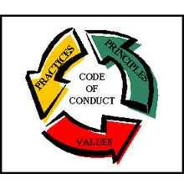
Model Standards of Conduct for Mediators
Standard I. Self Determination
Standard II. Impartiality
Standard III. Conflicts of Interest
Standard IV. Competence
Standard V. Confidentiality
Standard VI. Quality of Process
Standard VII. Advertising and Solicitation
Standard IX. Advancement of Mediation Practice
Notes:
MSCM does not apply to Rule 114 mediators, per se, but it serves to fill gaps – as it is more detailed – and may be found to constitute a standard of care, as the most commonly referenced national standard

Slide 14
Minnesota Civil Mediation Act
Minn. Stat. Sec. 572.33, subd. 4
Mediated settlement agreement.
Minn. Stat. Sec. 572.35, subd. 1
Effect of Mediated Settlement Agreement.
Minn. Stat. Sec. 572.36
Setting Aside or Reforming a Mediated Settlement Agreement. (“evident partiality”)
Minn. Stat. Sec. 572.37
Presentation of Mediator to Public.
Notes:
Important provisions – likely will cover in class, but if not, review these, as knowledge of these statutes is a key part of your competence as a MN mediator

Slide 15
Minn. Stat. 595.02 Testimony of Witnesses
“Competency” Standard
Minn. Stat. 595.02, Subd. 1 Competency of Witnesses (m) [Mediation]
Minn. Stat. 595.02, Subd. 1(a) Alternative dispute resolution privilege

Slide 16
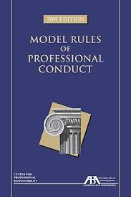
Minnesota Rules of Professional Conduct
Rule 1.12 Former Judge, Arbitrator, Mediator, or other Third-Party Neutral
Rule 2.4 Lawyer Serving as Third-Party Neutral
Notes:
Lawyer- Neutrals have increased accountability and duties to participants

Slide 17
Scenarios - Assumptions
Minnesota State Court Civil Matter – “court-annexed”
Rule 114 applies, unless there are specific facts to the contrary
“Rule” references are to Rule 114 and Rule 114 Code of Ethics, unless otherwise specified
“MSCM” refers to the Model Standards of Conduct for Mediators
Minnesota Rules of Professional Conduct [MRPC] may also apply in some cases
“Best Answers”

Slide 18
Advertising & Solicitation

Slide 19
1. Selecting a Rule 114 Mediator
When researching rostered Rule 114 mediators, the attorneys and parties review a number of brochures and websites.
Several of the prospective mediators refer to themselves as
“certified”.

Slide 20
1. This practice is:
a good, ethical marketing strategy.
“not appropriate” under Rule 114.13 (A) Subd. 6
an ethical violation under Rule 114.13 (A) Subd. 6 unless the mediator is “certified” in another state.
b) and c).

Slide 21
1. This practice is:
a good, ethical marketing strategy.
“not appropriate” under Rule 114.13 (A) Subd. 6
an ethical violation under Rule 114.13 (A) Subd. 6 unless the mediator is “certified” in another state.
b) and c).

Slide 22
“Qualified Neutral”
Rule 114.13 (A) Subd. 6. Advertising and Solicitation
“It is not appropriate to identify oneself as a ‘certified’ neutral.”
Correct PHRASE: “qualified neutral under Rule 114 of the General Rules of Practice.” [NOTE: This is a change from what was in the original new rule promulgated in July 2022.]
Tip: Conform your business cards, website, stationary, signature block, etc.
See MN ADR Handbook, p. 292-293
Notes:
You may use the term “certified” only if you truly are “certified” by another program or state, and you must specify the source of that certification to avoid confusion.
Yet misunderstood as the ADR Workgroup used the term “certified neutral” in some of their proposed revisions!

Slide 23
Why? Consumer Protection
Much ado about nothing?
“Certified” might be misleading
Neutrals who complete “certified” training and are on a roster are NOT “certified” in terms of having achieved a measurable level of competence; rather they have completed the training, possess the required background, and have paid the roster fee.
“Qualified” better encompasses the completion of these requirements
“Certified” in another state?
Neutrals are permitted to advertise this, as long as it is very clear that this certification is from another state, program or entity - NOT the State of MN

Slide 24
2. Advertising: What about success rates?
Can a mediator ethically advertise that they have a 95% success rate?
Yes, if this statement is accurate and truthful
No, because this statement is a promise of a specific result
Maybe not, if this statement is perceived as a promise of a specific result

Slide 25
2. Advertising: What about success rates?
Can a mediator ethically advertise that they have a 95% success rate?
Yes, if this statement is accurate and truthful
No, because this statement is a promise of a specific result
Maybe not, if this statement is perceived as a promise of a specific result

Slide 26
No Promises of Specific Results
Rule 114.13 (A) Subd. 6. Advertising and Solicitation Neutrals “shall refrain from promising specific results” - settlement as the outcome of the mediation. Also, Model Standards VII.A.1 and 3. (former rule to same effect)
Rule 114.13 (A) Subd. 8. Self-Determination in Mediation - It also may put pressure on the parties to settle, undermining the first principle of mediation. See also Model Standard I.
Practice Tip: Refrain from advertising settlement rates.

Slide 27
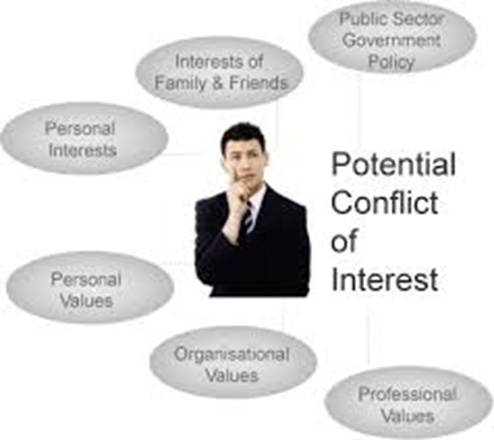
Conflicts of Interest & Disclosure

Slide 28
3. Mediators’ Affiliations
In a personal injury case, one of the mediators the parties are inclined to hire is a lawyer who – unbeknownst to the parties - has done a lot of work for an insurance company involved in the matter.

Slide 29
3. If the mediator is unaware of the parties’ insurers, the mediator:
has no duty to inquire about what the parties have not disclosed.
has a duty to ask the parties if they are aware of any conflicts of interest involving the mediator.
under the circumstances, should make a reasonable effort to determine what insurance companies may be affiliated with the parties.

Slide 30
3. If the mediator is unaware of the parties’ insurers, the mediator:
has no duty to inquire about what the parties have not disclosed.
has a duty to ask the parties if they are aware of any conflicts of interest involving the mediator.
under the circumstances, should make a reasonable effort to determine what insurance companies may be affiliated with the parties.

Slide 31
WHAT to Disclose

Slide 32
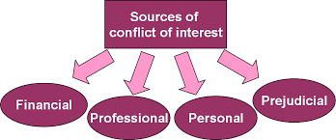
Conflicts of Interest Reasonably Creating an Appearance of Bias
“A conflict of interest is a direct or indirect financial or personal interest in the outcome of the proceeding or any existing or past financial, business, professional, family or social relationship which is likely to affect impartiality or which might reasonably create an appearance of partiality or bias.” (emphasis supplied) (Rule 114.13 (A) Subd. 2 Conflicts of Interest). See also MSCM STD III. A. Conflicts of Interest

Slide 33
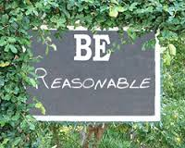
Conflicts “Reasonably Known”
Disclose actual and potential conflicts of interest “reasonably known” to the neutral. Rule 114.13 (A) Subd. 2 Conflicts of Interest
Make a “reasonable inquiry” to determine if such conflicts exist. MSCM STD. III. B.

Slide 34
Reasonable Inquiry?
What constitutes a “reasonable inquiry”?
Inquiring of parties
Subject matter
All parties
All counsel
All known witnesses
Previous contacts by parties and counsel with neutral and neutral’s firm
Internal conflicts check where applicable
Other? DEPENDS

Slide 35
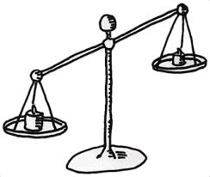
In Sum – WHAT to Disclose
Disclose ALL Conflicts of Interest – all facts that might “reasonably create” an appearance of partiality or bias – that are “reasonably known” after “reasonable inquiry”
MN ADR Handbook, p. 300
Notes:
Edna Sussman disclosure….

Slide 36
When to Disclose

Slide 37
When: Mediators/Other Neutrals: Before Serving
Rule 114 (A) Subd. 2. (a) “When” is not directly addressed for mediators and other non-arbitrators. However, neutrals “may serve, with consent of the parties “[a]fter disclosure”, evidencing the intent that conflicts “reasonably known” should be disclosed before serving.
MSCM STD III.C. A mediator shall disclose, as soon as practicable, …

Slide 38
4. Mid-Stream Conflict
What if the mediation has already begun before the mediator realizes that one of the parties is insured by one of the mediator’s clients?

Slide 39
4. The mediator:
Should disclose potential conflict of interest, but can continue to serve if the parties desire
Should disclose potential conflict of interest and decline to continue to serve
Has discretion about what to do depending on how far along the mediation has progressed
Should not disclose potential conflict of interest because it would negatively affect the quality of the process

Slide 40
4. The mediator:
Should disclose potential conflict of interest, but can continue to serve if the parties desire
Should disclose potential conflict of interest and decline to continue to serve
Has discretion about what to do depending on how far along the mediation has progressed
Should not disclose potential conflict of interest because it would negatively affect the quality of the process

Slide 41
When: Continuing Obligation
Mediators - before serving or continuing to serve
Rule 114 (A) Subd. 2. (a)
See MSCM STD III. D, requiring disclosure of conflicts arising after accepting appointment, “as quickly as practicable.”

Slide 42
How to Disclose

Slide 43
How: Details in Writing – Best Practice
Rule 114.13 (A) Subd. 2. (b)
“Neutrals acting as arbitrators shall disclose to the parties in writing….”
Other neutrals: writing not required, but best practice
TIP: DETAILS
General nature of the conflict(s)
Frequency
Timing
Significance of relationships or circumstances
Assertion that facts disclosed will not affect impartiality – if believe can proceed
“Reasonable Inquiry”
Parties informed consent to proceed where obtained
CAVEAT: Do Not Disclose Confidential Information from another proceeding or attorney-client relationship.
MN ADR Handbook, 301

Slide 44
How: Format
Disclosure of Potential Conflict
Retention Agreement
Administrator’s Form
Agreement to Mediate
Letter to All
Acknowledgement & Consent to Proceed
May be incorporated in above documents
May be in a separate writing
MN ADR Handbook, 301

Slide 45
After Disclosure

Slide 46
After Disclosure: Serve or Decline/Withdraw?
To serve or not to serve?
Rule 114.13 (A) Subd. 2.(a); “may serve, with the consent of the parties.”
MSCM STD III. D. “if all parties agree, the mediator may proceed…”
MN ADR Handbook, 302-303

Slide 47
After Disclosure: Integrity of the Process
CAVEAT
If all parties choose to retain, the neutral may proceed, unless the mediator believes that the conflict of interest would inhibit the mediator’s impartiality. Rule 114.13 (A) Subd. 2. (a)

Slide 48
After Disclosure: “Exercise Caution”
“Even with the consent of the parties, the Neutral must exercise caution in circumstances that would raise legitimate questions about the integrity of the ADR process. If a conflict of interest impairs a Neutral’s impartiality, the Neutral shall withdraw regardless of the consent of the parties.” Rule 114.13 (A) Subd. 2. (a)

Slide 49
Consequences : Failure to Disclose or Withdraw

Slide 50
Consequences: Failure to Disclose or Withdraw
Parties
Setting Aside or Reforming a Mediated Settlement Agreement – MN Civil Mediation Act
Increased expense & inefficiency
Decline in confidence in the process
Neutral
Personal –
Reputation for quality process
Professional integrity
Ethical –
Discipline
Removal from roster or panel

Slide 51
In Sum: Conflicts Disclosure Process
Make a “Reasonable Inquiry” to Discover Conflicts
Disclose Conflicts
Consider Impact of Conflicts
Continue
If all parties agree AND
If neutral assesses that Conflict will not interfere with ethical duties
Withdraw
If any party so desires OR
If neutral assesses that Conflict MAY interfere with ethical duties
Continuing obligation to disclose and assess impact of potential conflicts

Slide 52
Mediator Experience

Slide 53
5. Mediator Experience
One of the prospective mediators in a matter has no experience in the substantive area of law at issue.

Slide 54
3. The mediator should:
decline assignment because mediator has no substantive experience in the area.
disclose lack of substantive experience and serve if parties desire.
disclose lack of substantive experience, analyze whether he/she has the qualifications and ability to fulfill the role, and if so, serve if parties desire.

Slide 55
3. The mediator should:
decline assignment because mediator has no substantive experience in the area.
disclose lack of substantive experience and serve if parties desire.
disclose lack of substantive experience, analyze whether he/she has the qualifications and ability to fulfill the role, and if so, serve if parties desire.

Slide 56
New Competency Standard : “Qualifications and Ability to Fulfill the Role”
Subject matter expertise is not required.
STANDARD: Rule 114.13 (A) Subd. 3 Competence requires that the neutral may only serve when “they possess the qualifications and ability to fulfill the role that the Neutral has been requested or assigned to serve…”
Rule 114.13 (A) Subd. 3 Competence – neutral “must decline appointment, request assistance, or withdraw when a dispute is beyond the neutral’s competence.”

Slide 57
Practice Tip: Disclose, Consider, Consent
Disclose relevant training, education, and experience
Analyze whether he/she has the “qualifications and ability” to fulfill requested role).
Serve if the parties still want to hire after disclosure and assessment
Get assent/waiver in writing

Slide 58
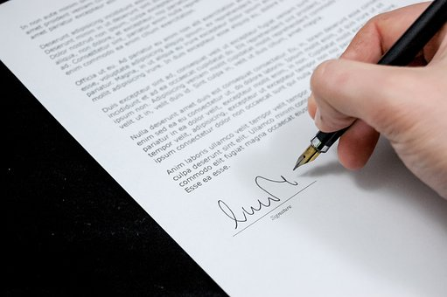
Retaining the Mediator

Slide 59
6. Mediator Fees
The parties in a “court-annexed” matter are considering retaining a mediator who orally offers the following fee structure: nothing unless an agreement is reached, $400 per hour if an agreement is reached. In this conversation the mediator also explains their background and all agree to go forward.

Slide 60
6. Is this ethical?
No, Rule 114 prohibits contingency fees.
No, Rule 114 requires fee agreements to be in writing.
Yes, Rule 114 permits this type of agreement to mediate.
Yes, Rule 114 permits this, if the parties understand the fees and background of the neutral.
It’s unclear; Rule 114 does not explicitly address fee agreements.
a. and b.

Slide 61
6. Is this ethical?
No, Rule 114 prohibits contingency fees.
No, Rule 114 requires fee agreements to be in writing.
Yes, Rule 114 permits this type of agreement to mediate.
Yes, Rule 114 permits this, if the parties understand the fees and background of the neutral.
It’s unclear; Rule 114 does not explicitly address fee agreements.
a. and b.

Slide 62
No Contingency Fees or Referral Fees
No Contingency Fees - Rule 114.13 (A) Subd. 7. (a) Fees. - prohibits fees contingent upon the outcome of the mediation. See also MSCM VIII. B. 1.
NOTE: No Referral Fees - Can't offer reduced mediation fee in exchange for referrals either. Rule 114.13 (A) Subd. 7. (a) prohibits a neutral from giving or receiving “any commission, rebate, or similar remuneration” for referrals. Model Standards of Conduct is silent on this issue.

Slide 63
Fees Fully Explained in Advance & in Writing
Rule 114.13 (A) Subd. 7. (a) Fees provides that “[a] neutral shall fully disclose and explain the basis of compensation, fees and charges to the parties. The parties shall be provided with sufficient information about fees at the outset to determine if they wish to retain the services of the neutral.”
Rule 114.13 (A) Subd. 7. (a) Fees requires that “[t]he fee agreement shall be included in the written agreement and shall be included in the written agreement and shall be consistent with a court order appointing the neutral.”

Slide 64
Neutral’s Burden to Correct Errant Court Order [NEW]
Signed written agreement must be consistent with court order appointing neutral
BUT …
If the court requires the Neutral to do something that would violate Rule 114 or other applicable court rules or statutes …
Then the Neutral must decline or defer appointment until amendment of the order is obtained
Burden is on the neutral to educate court about neutral’s duties under the rules
Rule 114.13 (A) Subd. 7(b)

Slide 65
114.13 (A) Subd. 7(a) Fees: Neutral Duties
“The fee agreement shall be included in the written agreement…”
“A Neutral shall establish a protocol for regularly advising parties on the status of their account and requesting payment of fees.”
Neutral may withdraw, proceed or postpone if one party does not pay the fee and no other party covers the fee.
“…the Neutral shall not refuse participation by any party based on payment status.”
Neutral shall return any unearned fees.
NEW

Slide 66
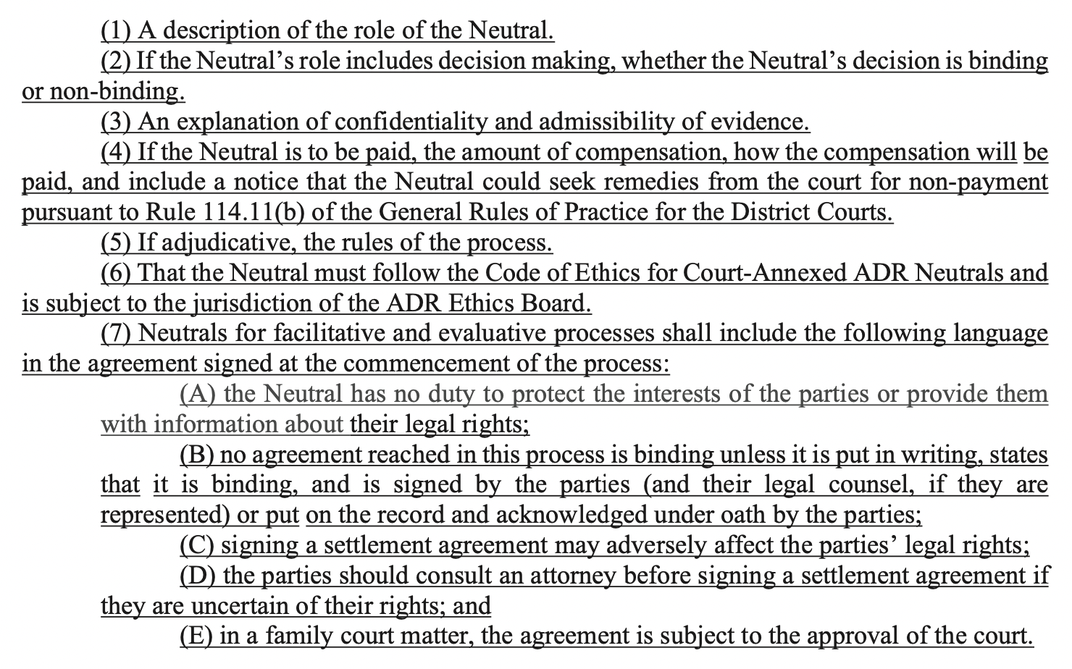
Agreements for ADR Services/Fees Must Be in Writing
Rule 114.13 (A) Subd. 7. (b): Written agreements for ADR services are required in “court-annexed” matters – including:

Slide 67
Mediator Tip: Conform Your Agreements
Remember: Requirements only apply in Minnesota State Court matters
Consider what provisions might work in both court-annexed and other matters
Many of the requirements reflect your Rule 114 ethical obligations
Rule 114.13 A. Subd. 7(b)(7) (A) through (D) incorporates what is already considered “best practice” to include in Agreements to Mediate to ensure enforceability. See Minnesota Civil Mediation Act

Slide 68
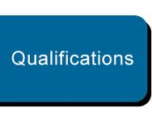
Written Statement of Qualifications in Advance
Rule 114.13 (A) Subd. 3. Competence “No individual may act as a Neutral for compensation without providing the individuals to the conflict with a written statement of qualifications prior to beginning services.”

Slide 69
MN Civil Mediation Act: Statement of Qualifications
“No individual may act as a mediator pursuant to the Minnesota Civil Mediation Act for compensation without providing the individuals to the conflict with a written statement of qualifications prior to beginning mediation. The statement shall describe the educational background and relevant training and experience in the field.”
Minn. Stat. 572.37 Presentation of Mediator to Public.

Slide 70
Practice Tip: Not “Court-Annexed”?
Fees – no requirements from Rule 114
Written Agreements – no requirements from Rule 114
Statement of Qualifications – no requirements from Rule 114
CONSIDER
MN Civil Mediation Act requirements – “written agreement” to mediate; “written statement of qualifications”
Model Standards of Conduct for Mediators – “fee arrangement should be in writing” e.g., MSCM STD VIII. A. 2.
Best Practices
Consistency across your own ADR practice
Possibility that the matter may become court-annexed in the near future

Slide 71
Unrepresented Parties

Slide 72
7. Mediator’s Introduction
At the beginning of a court-annexed mediation, the mediator introduces herself to the parties - one of whom is unrepresented - by saying that she is a lawyer with over 20 years of practice in housing law, handling many matters both large and small and, accordingly, has a lot of experience pertinent to the dispute.
Notes:
Think about replacing this one – can of worms and too difficult

Slide 73
7. Does this introduction raise any ethical issues?
No, it is all true and assures the parties of her competence.
No, it provides parties with information about her relevant experience in the field, as required by Rule 114 and Minn. Stat. 572.37.
Yes, it sounds too much like promising results.
Maybe, if the unrepresented party does not understand the mediator’s role.

Slide 74
7. Does this introduction raise any ethical issues?
No, it is all true and assures the parties of her competence.
No, it provides parties with information about her relevant experience in the field, as required by Rule 114 and Minn. Stat. 572.37.
Yes, it sounds too much like promising results.
Maybe, if the unrepresented party does not understand the mediator’s role.

Slide 75
Unrepresented Parties & Lawyer-Mediator: Inform & Explain
If the parties are unrepresented, MRPC 2.4 requires a lawyer-neutral to inform unrepresented parties that the neutral is not representing them.
If there is reason to believe an unrepresented party does not understand the difference, MRPC 2.4 requires the mediator to explain the difference between a lawyer’s role in representing a client and the lawyer-neutral’s role as a neutral in the ADR process.
Practice tip: Include a statement of role in Agreement for ADR services.
Rule 114 (A) Subd. 7(b)(1): Description of role required.

Slide 76
The Neutral’s Role
MN ADR Handbook, p. 283
Caveat: Check for compliance with NEW Rule

Slide 77
Unrepresented Parties: Proceed with Caution
Working with pro se parties involves special ethical and practical challenges
Requires careful disclosures and careful balancing of sometimes conflicting ethical obligations
Most difficult dilemmas for the neutral involve balancing:
Impartiality – avoiding the appearance of partiality
Quality of the process – uphold fairness and integrity of process

Slide 78
Impact on Impartiality
Rule 114.13. A. Subd. 1. Impartiality . “….Impartiality means freedom from favoritism or bias either by word or action, and a commitment to serve all parties as opposed to a single party. If at any time the neutral is unable to conduct the process in an impartial manner, the neutral shall withdraw.”

Slide 79
Quality of the Process
Rule 114.13 (A) Subd. 5. Quality of the Process. “A neutral shall withdraw from an ADR process or postpone a session….,..if a party is unable to participate due to drug or alcohol abuse, or other physical or mental incapacity.”

Slide 80
8. Party Competence
Suppose this is a housing court mediation and as the mediation progresses, the unrepresented party seems distracted and seems to be having trouble following the discussion, asking the mediator frequently, “What should I do?”

Slide 81
8. Can the Mediator continue?
Yes, mediator can continue, answering the party’s questions
Yes, mediator can continue, but remind all parties of his/her role
No, mediator should pause, inquire, and assess the party’s capacity to participate
No, the mediator should withdraw

Slide 82
8. Can the Mediator continue?
Yes, mediator can continue, answering the party’s questions
Yes, mediator can continue, but remind all parties of his/her role
No, mediator should pause, inquire, and assess the party’s capacity to participate
No, the mediator should withdraw

Slide 83
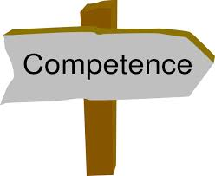
Party Competency Issues
Prohibited Actions
Quality of the Process
Self-Determination
Impartiality
Lawyer Serving as Third-Party Neutral

Slide 84
Rule 114.13 (A) Subd. 7(c) “Prohibited Actions”
Facilitative & Evaluative Neutrals
Drafting
Therapy
Legal Representation
Legal Advice

Slide 85
Rule 114.13 (A) Subd. 7(c)(1): Drafting
“A Neutral in a facilitative or evaluative process shall not:
(1) Draft legal documents that are intended to be submitted to the court as an order to be signed by a judge or judicial officer…” (emphasis supplied)

Slide 86
Rule 114.13 (A) Subd. 7(c)(2): Therapy
“A Neutral in a facilitative or evaluative process shall not:
(2) …provide therapy to either party … during an ADR process … (emphasis supplied)

Slide 87
Rule 114.13 (A) Subd. 7(c)(2): Legal Advice
“A Neutral in a facilitative or evaluative process shall not:
(2) …provide legal representation or advice to any party or engage in the unauthorized practice of law in any matter during an ADR process… (emphasis supplied)

Slide 88
Quality of the Process
Rule 114.13 (A) Subd. 5 “A Neutral shall withdraw from an ADR process or postpone a session….,..if a party is unable to participate due to drug or alcohol abuse, or other physical or mental incapacity.”
Model Standard VI.A.10. If a party appears to have difficulty comprehending the process, issues, or settlement options, or difficulty participating in a mediation, the mediator should explore the circumstances and potential accommodations, modifications or adjustments that would make possible the party’s capacity to comprehend, participate and exercise self-determination.

Slide 89
Impact on Impartiality
Rule 114.13 (A) Subd. 1. Impartiality
“….If at any time the Neutral is unable to conduct the process in an impartial manner, the Neutral shall withdraw.”
“….Impartiality means freedom from favoritism or bias either by word or action, and a commitment to serve all parties as opposed to a single party.”

Slide 90
Assessing & Addressing Competency
Assessing Competency:
Does the participant understand the process?
Do they have enough info to make informed decisions?
Are they capable of negotiating in own best interests?
Are they acting of their own free will?
Are they capable of understanding the known potential consequences of their decisions?
MN ADR Handbook, p. 283-4

Slide 91
Assessing & Addressing Competency
Addressing Competency
Remind the all parties of the neutral’s role
Make party aware of importance of consulting other professionals to help make informed decisions
Inquire about problems and potential accommodations, such as a support person
Suggest a recess to think and consider options
Check-in periodically
Allow time for attorney review of settlement agreement
Postpone to allow party to obtain assistance
Withdraw
MN ADR Handbook, p. 284-6
p. 312-4

Slide 92
Intervene and Assist with Caution
“The critical inquiry is how to intervene on behalf of an unrepresented party to support self-determination and a quality process, without undermining the neutral’s impartiality – or appearance of impartiality - and the integrity and fairness of the process for all parties.”
MN ADR Handbook, p. 284-5

Slide 93
Final Word: Serve All Parties
MN ADR Handbook, 286-287

Slide 94
Impartiality

Slide 95
9. Mediator Antipathy
In the course of a mediation, you as the mediator conclude inwardly that one of the parties is an insufferable, arrogant, irresponsible cad.

Slide 96
9. You should:
continue to serve, but self-monitor to assure you do not demonstrate partiality/antipathy.
continue to serve, UNLESS you conclude the antipathy affects your ability to remain impartial, then withdraw.
tell the parties you can no longer serve and withdraw.

Slide 97
9. You should:
continue to serve, but self-monitor to assure you do not demonstrate partiality/antipathy.
continue to serve, UNLESS you conclude the antipathy affects your ability to remain impartial, then withdraw.
tell the parties you can no longer serve and withdraw.

Slide 98
The Balance of Impartiality
Rule 114.13 (A) Subd. 1. Impartiality requires a neutral to conduct an impartial process and to withdraw if cannot remain impartial.
Minn. Stat. 572.36 Setting Aside or Reforming a Mediated Settlement Agreement – court shall set aside mediated settlement agreement for “evident partiality” of the mediator.
Model Standard II.B.1 and II.C - Impartiality states that a mediator should not act with partiality based on any participants “personal characteristics” and to withdraw in such circumstances.

Slide 99
Self-Determination

Slide 100
10. Break please?
The mediation begins at 10:00 a.m. At 1:00 p.m., the parties say they would like to take a lunch break. The mediator says “No, you are making good progress, and I am only available until 4:00 this afternoon, so let’s keep going and see if we can settle this.”

Slide 101
10. This conduct is:
Ethical because the mediator is trying to “expedite the process” as required for a quality process.
Unethical because the mediator did not honor the parties’ request, violating self-determination.
Unethical because the mediator’s action is “prohibited” under Rule 114.13 (A)
b. and c.

Slide 102
10. This conduct is:
Ethical because the mediator is trying to “expedite the process” as required for a quality process.
Unethical because the mediator did not honor the parties’ request, violating self-determination.
Unethical because the mediator’s action is “prohibited” under Rule 114.13 (A)
b. and c.

Slide 103
Mediators/Evaluators: Requiring Parties to Stay is a “Prohibited Action”
Rule 114.13 (A) Subd. 5 Quality of Process, “A neutral shall ensure that the reasonable expectations of the parties concerning the timing of the process are satisfied … and shall exert every reasonable effort to expedite the process.”
Rule 114.13 (A) Subd. 7(c)(3) Prohibited Actions – “A Neutral in a facilitative or evaluative process shall not: … (3) Require a party to stay in the ADR process or attempt to coerce an agreement between the parties.” (emphasis supplied)
Rule 114.13 (A) Subd. 8 Self-Determination in Mediation. “A mediator shall act in a manner that recognizes that mediation is based on the principle of self-determination by the parties.”
MSCM I - Self Determination requires that parties make “free and informed choices as to process and outcome.”
Notes:
This is one rather innocent example of a violation of the precept of self-determination – in a facilitative model, self-determination is always at the top of the hierarchy of values

Slide 104
Communication

Slide 105
11. Caucus Confidentiality
At one point in the mediation, the mediator is caucusing with Defendant who says, “You know, if I get stuck paying more than $40,000 in this case, I’m going to declare bankruptcy. Don’t tell Plaintiff, though.”

Slide 106
11. What should the mediator do?
Must keep the secret unless authorized by party to reveal.
Reveal this information if it will help facilitate settlement.
Wait to see if Defendant ends up getting stuck with paying more than $40,000 and only then reveal the confidential information.
None of the above.

Slide 107
11. What should the mediator do?
Must keep the secret unless authorized by party to reveal.
Reveal this information if it will help facilitate settlement.
Wait to see if Defendant ends up getting stuck with paying more than $40,000 and only then reveal the confidential information.
None of the above.

Slide 108
Caucus Confidentiality
Rule 114.10(b) Communication with Parties and Court in ADR Processes
In evaluative, facilitative and hybrid processes, [p]arties and their counsel may communicate ex parte with the Neutral … with the consent of the Neutral, so long as the communication encourages or facilitates settlement.”
Some Mediators → All is “public” unless identify specific confidential information
MSCM STD V.B.→ All is confidential unless permission to share

Slide 109
Discuss Expectations for Caucus Confidentiality at the Outset
Rule 114.13 (A) Subd. 4. Confidentiality requires the neutral to “maintain confidentiality as required by Rules 114.08, 114.10, and 114.11… and any additional agreements made with or between the parties.”
Rule 114.13 (A) Subd. 4. Confidentiality “The Neutral shall discuss issues of confidentiality with the parties before beginning an ADR process including limitations on the scope of confidentiality and the extent of confidentiality provided in any private sessions....”

Slide 110
Practice Tips: Caucus Confidentiality
Practice Tip: Mediator and parties should come to a clear understanding, before the first caucus, of the precise extent of confidentiality of communications during caucuses.
Practice Tip: Verify at the close of every caucus what may be disclosed.

Slide 111
Withdraw?
Rule 114.13 (A) Subd. 5. Quality of the Process – would require the mediator to withdraw “if the process is being used to further illegal conduct”
Rule 114.13 (A) Subd. 1. Impartiality– “Neutral shall withdraw…” if “unable to conduct the process in an impartial manner”.
Practice Tip: The mediator may explore with Defendant the implications of telling or not telling

Slide 112
12. Communication with the Court
Plaintiff has filed and served a motion to compel discovery against Defendant. Defendant files an affidavit stating he responded to the discovery during mediation. The judge phones the mediator and asks for the mediator’s input regarding what information was exchanged during the mediation.

Slide 113
12. How should the mediator respond?
Verify or contradict the information in Defendant’s affidavit, depending on what the mediator remembers
Refuse to answer and advise the court that Rule 114 prohibits the mediator from communicating with the court about what happened at the mediation, absent consent of the parties or a court order
Refuse to verify or contradict the information, but tell the Court that a ruling on the motion would facilitate the mediation process
Refuse to speak with the court

Slide 114
12. How should the mediator respond?
Verify or contradict the information in Defendant’s affidavit, depending on what the mediator remembers
Refuse to answer and advise the court that Rule 114 prohibits the mediator from communicating with the court about what happened at the mediation, absent consent of the parties or a court order
Refuse to verify or contradict the information, but tell the Court that a ruling on the motion would facilitate the mediation process
Refuse to speak with the court

Slide 115
Rule 114.10 Communications with Parties and Court
Rule 114.10(c) Communications to Court during an ADR Process: Neutral may inform the court:
Whether case has undergone ADR and whether settled
Failure to attend or pay court ordered fees
Request by parties for additional time
With parties’ written consent, procedural action by court that would facilitate
Neutral’s assessment that case is inappropriate for that ADR process
Information obtained during ADR process, with parties’ consent or court order
Rule 114.10(d) Communications to Court after an ADR Process: Neutral may inform the court:
Whether case has settled and copy of agreement
Case has not settled and with written consent, court actions that would facilitate
Failure to pay some or all of the fees
Notice of parenting time adjustments

Slide 116
13. Suit to Enforce Settlement Agreement
Through mediation, the parties agreed to settle an employment matter and signed a memo of understanding. The settlement falls apart in the drafting and one party sues to enforce the settlement terms agreed to at the mediation. That party calls the mediator to testify as to his/her recollections as to what was discussed at mediation about the settlement terms.
Notes:
Memo of Understanding: “parties intend this to be final and binding; attorneys will draft formal settlement agreement consistent with these terms”

Slide 117
13. Pursuant to MN ADR statutes and rules, can mediator testify about his/her recollection?
Yes, if both parties consent.
Yes, this is permitted testimony, regardless of consent.
No, mediator is not “competent” to testify.
No, unless there is no other way to get this information.

Slide 118
13. Pursuant to MN ADR statutes and rules, can mediator testify about his/her recollection?
Yes, if both parties consent.
Yes, this is permitted testimony, regardless of consent.
No, mediator is not “competent” to testify.
No, unless there is no other way to get this information.

Slide 119
Mediators: “Not Competent” to Testify
Minn. Stat. 595.02, Subd. 1a. ADR Privilege
Mediators shall not …. “be competent to testify, in any subsequent civil proceeding …. as to any statement … occurring at or in conjunction with the prior” mediation…, “except as to any statement or conduct that could:
(1) constitute a crime;
(2) give rise to disqualification proceedings under the Rules of Professional Conduct for attorneys; or
(3) constitute professional misconduct.”
Notes:
MN uses a COMPETENCY standard – near the most restrictive of standards for mediator.
Other evidentiary rules may also come into play to prohibit this testimony

Slide 120
Mediation Statements Inadmissible
Rule 114.07 Use of ADR Evidence in Court
“(b) Inadmissibility. Subject to Minnesota Statutes, section 595.02, … no statements made …in non-binding ADR processes that are not otherwise discoverable shall be subject to discovery or other disclosure. Such evidence is inadmissible for any purpose at a later trial, including for impeachment.” (emphasis supplied)

Slide 121
Conflicts of Interest: Subsequent Representation

Slide 122
14. New Business?
Plaintiff was so impressed with the mediator’s substantive knowledge that, three months after the mediation, Plaintiff asked the mediator if the mediator would represent her in another lawsuit.

Slide 123
14. The mediator:
may take the new case; it raises no ethical issues.
may take the case with the oral consent of the parties and if 3 months is a “reasonable time”.
may take the case IF the new lawsuit does not involve a substantially factually-related matter.
may NOT take the case.

Slide 124
14. The mediator:
may take the new case; it raises no ethical issues.
may take the case with the oral consent of the parties and if 3 months is a “reasonable time”.
may take the case IF the new lawsuit does not involve a substantially factually-related matter.
may NOT take the case.

Slide 125
Conflicts of Interest: Subsequent Representation
Minnesota Rules of Professional Conduct 1.12 Former Judge, Arbitrator, Mediator, or Other Third-Party Neutral
Rule 114.13 (A) Subd. 2 Conflicts of Interest
MSCM STD III. F.

Slide 126
Theme: Integrity of the Process
Impartiality
Actual or Perceived Conflict of Interest
Related Matter/Unrelated Matter
Consent
Time Elapsed
Integrity of the Process

Slide 127
“Participated Personally and Substantially”
Minn. R. Prof. Conduct 1.12(a) – Former Neutral, prohibits lawyer-neutrals from later representing anyone in connection with a matter in which the lawyer “participated personally and substantially” as a neutral, unless all parties “give informed consent, confirmed in writing”.

Slide 128
“Substantially Factually Related Matter”
Rule 114.13 (A) Subd. 2. (a)Conflicts of Interest.
“Without the consent of all parties, and for a reasonable time under the particular circumstances, a Neutral who also practices in another profession shall not establish a professional relationship in that other profession with one of the parties, or any person or entity, in a substantially factually related matter.”

Slide 129
MSCM STD III. F. Conflicts of Interest
“Subsequent to a mediation, a mediator shall not establish another relationship with any of the participants in any matter that would raise questions about the integrity of the mediation. … the mediator should consider factors such as time elapsed…, the nature of the relationships established, and services offered when determining whether the relationships might create a perceived or actual conflict of interest.”

Slide 130
In Sum: The “Smell Test”
Related Matter
“Participated personally and substantially” - MRPC 1.12
“Substantially factually related matter” - Rule 114
Reasonable Time - Rule 114
Consent – MRPC 1.12 & Rule 114
Related or Unrelated Matter
Integrity of the Process
Appearance of Impartiality
“Smell Test”

Slide 131
READ THE RULES!

Slide 133
Resources
Rule 114 of the Minnesota General Rules of Practice for District Courts
https://www.revisor.mn.gov/court_rules/gp/id/114/
ORDER PROMULGATING AMENDMENTS TO THE GENERAL RULES OF PRACTICE FOR THE DISTRICT COURTS - July 13, 2022, ADM09-8009
https://www.mncourts.gov/mncourtsgov/media/Appellate/Supreme%20Court/RecentRulesOrders/ORADM098009-071322.pdf
ADR-Rule 114 Neutral Roster Individual Application Form
https://www.mncourts.gov/mncourtsgov/media/scao_library/ADR/Individual_Application.pdf
Model Standards of Conduct for Mediators (ABA/AAA/ACR)(2005)
https://www.americanbar.org/content/dam/aba/administrative/dispute_resolution/dispute_resolution/model_standards_conduct_april2007.pdf

Slide 134
Acknowledgements
Some of the ethical dilemmas upon which this presentation is based were originally developed by Rebecca Picard in March 2000 for a presentation for Minnesota CLE on mediation ethics.
Those problems were updated, expanded and adapted by me, Linda Mealey-Lohmann and Rebecca Picard for use in our ADR classes at William Mitchell College of Law in 2009 and subsequent terms.
Significant further additions, deletions, revisions and updates were made by me for subsequent presentations and for this presentation today about Core Ethics for Minnesota Mediators.
Questions? Feel free to contact me at leslie@lesliemcevoy.com

Slide 135
Leslie Sinner McEvoy, Esq.
Mediator, Arbitrator, Teacher, Trainer and Consultant
Teaching, Studying, Writing about Rule 114 since 2008
Website: www.lesliemcevoy.com
Email:
leslie@lesliemcevoy.com
mcevoyleslie@gmail.com
Notes:
This is a brand new rule. I am as eager to share what I have learned as to learn from all of you. Please participate in the polls that ask about you and that ask for your impressions. Please feel free to ask questions or make comments, I will get to as many as I can and I will get back to you after the course if I am unable to do so in our time today.

